Slide 1
Vertical Alignment
&
Power Standards Training

Slide 2
Today’s Schedule
Overview of Vertical Alignment
1:15-1:20
Introduction of Power Standards Training 1:20-1:55
Sessions 1 & 2
2-3:25

Slide 3
Vertical Alignment Schedule
Session 1
Session 2
1:40-2:20 - Session 1
K-1
2-3
4-5
2:25-3:05 - Session 2
1-2
3-4
K & 5 Work on Power Standards

Slide 4
Vertical Alignment
Why?
To align standards across grade levels and develop a deep understanding of what is required across grade levels.
How deep will we go?

Slide 5
What you will do?
Step 1 - The following groups:
(Session 1) - K-1, 2-3, 4-5
(Session 2) - 1-2, 3-4, K & 5 will work on KEA and PS
Step 2 - Upper grade level teachers will share the following:
What standards do students have problems being consistently proficient?
Share strategies on how they believe the lower grade level could address their concerns.

Slide 6
Continued...
Step 3 - Teachers will write the standards discussed and their ideas and strategies for addressing.
The lower grade level will keep this poster and use at their next PLC meeting.

Slide 7
and repeat...
We will repeat this process with the following grade levels meeting:
1-2
3-4
Kindergarten and 5th - you will start to work on your Power Standards.
1, 2, 4 - We will work on Power Standards during PLCs next week.

Slide 8
Power Standards Training

Slide 9
Essential Questions
What difference would fewer content standards have on student learning?
Who should determine what students need to know?
How should you determine what the students in your classroom need to learn?

Slide 10
Outcomes
By the end of this training I will…
Understand the rationale and process for determining power standards for student learning
Identify power standards with my PLC colleagues for our classrooms
Design assessments aligned to the power standards to measure student learning

Slide 11
Norms
Start & end punctually
Listen actively
Disagree respectfully
Participate enthusiastically
Focus completely (monitor your technology)
Have fun
What is learned here leaves here

Slide 12
Setting the Stage
“We learn best by asking essential questions and testing tentative answers against reason and fact in a continual…circle of honest debate.”
- Socrates

Slide 13
The Rationale

Slide 14
The Need to Prioritize
“Teachers need to prioritize a set of content standards so they can identify the content standards at which they will devote powerful, thoroughgoing instruction, and then they need to formally and systematically assess student mastery of only those high-priority content standards.”
( W. James Popham, Test Better, Teach Better: The Instructional Role of Assessment, ASCD, 2003, p. 36)

Slide 15
Have you ever wondered…
So many standards (indicators), so little time! How can teachers effectively teach and assess them all?

Slide 16
Consider These Facts
1025 hours per year X 13 years = 13,325 total hours of K-12 instruction
McREL identified 200 standards and 3093 benchmarks (indicators) in national- and state-level documents across 14 different subject areas
Classroom teachers estimated a need for 15,465 hours to adequately teach them all

Slide 17
Time Actually Devoted to Instruction
Varies widely from a low of 21% to high of 69%
Taking highest estimate of 69%, only 9194 hours are actually available for instruction out of the original 13,325 hours total
Can 200 standards and 3093 benchmarks needing 15,465 hours be taught in only 9194 hours of instructional time? No!
Robert Marzano, What Works in Schools,
ASCD, 2003, pp. 24-25.

Slide 18
More Years In School ?
“To cover all this content, you would have to change schooling from K-12 to K-22…The sheer number of standards is the biggest impediment to implementing standards…By my reckoning, we would have to cut content by about two-thirds.”
Robert Marzano, Educational Leadership, Sept. 2001, p. 15

Slide 19
Power Standards
Narrow the standards and indicators by:
Power Standards = more time and emphasis
Complementary Standards = supports the Power Standards
Teach the Complementary in the context of or enhances the Power Standards
Prioritization, not elimination!

Slide 20
Defining Power Standards

Slide 21
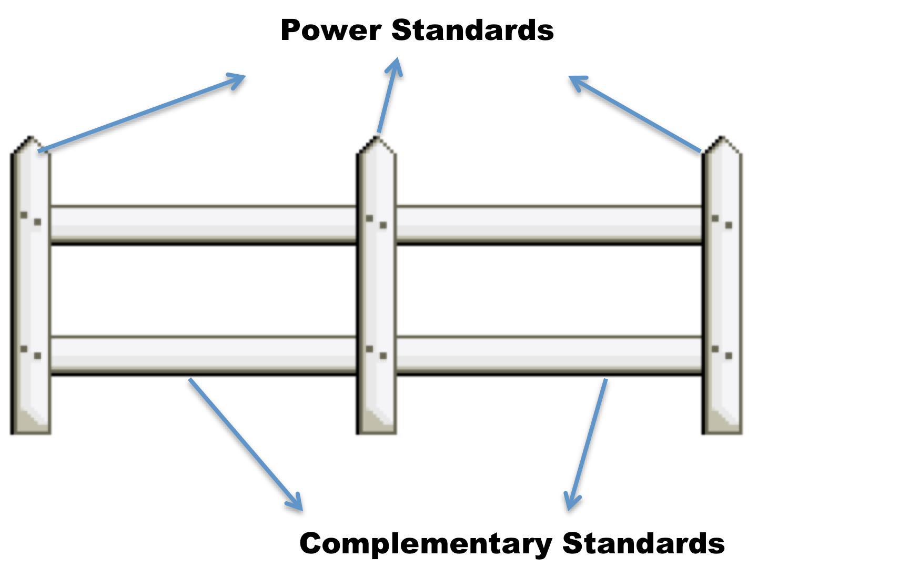
Power Standards and Complementary Standards
Like fence postholes, Power Standards provide curricular focus in which teachers need to “dig deeper” and assure student competency.
Like fence rails, “Complementary Standards” are curricular standards which connect to and support Power Standards.

Slide 22
But The State Tests All Standards!
Good set of Power Standards will address about 88% of the items on the state test, but not 100%
If you go after that extra 12%, you will have to cover many more standards (indicators) and have less time to teach the truly essential ones
Rationale: better to be proficient at 88% of what will probably be on state test versus exposure to 100% of what could be on test

Slide 23
Selecting Power Standards

Slide 24
Article Debrief & Highlights
“What knowledge and skills do this year’s students need so they will enter next year’s class with confidence and a readiness for success?”
PRIORITIZE the standards by distinguishing the “essentials”!
Teach the remaining standards in the context of the essentials!
Critical message for everyone to remember: prioritization, not elimination!
Power Standards provide FOCUS for both instruction and assessment

Slide 25
Selection & Alignment
To Complete December 14
Step 1: Prioritize Standards
Training in the future….
Step 2: Differentiate Standards
Step 3: Finalize Standards

Slide 26
Agenda
Prioritize Standards using the Excel Sheet
Create a Tree Map to differentiate between Power Standards and Complimentary Standards
Create a Flow Map to identify the sequencing of Power Standards for your PLC for the 1st and 2nd marking periods

Slide 27
Steps 1: Prioritize All Standards

Slide 28
Selection and Alignment
Selection of Power Standards based on criteria of endurance, leverage, and readiness for next level of learning
Power Standards vertically aligned from one grade to the next, one course to the next, until there is a K-12 vertical “flow” of standards

Slide 29
Steps 1: Prioritize All Standards
Establish a specific reduction target (i.e., no more than 20)
For your role TODAY…Eliminate verbs and pay attention to nouns – nouns identify content (verbs come later)
Identify standards using three criteria
Endurance: The standard provides knowledge and skills beyond the test date
Leverage: The standard provides knowledge & skills of value beyond the classroom
Readiness for the next level: The standard is needed for success down the road (next year, in 8th grade, in college, etc.)

Slide 30
Steps 1: Prioritize All Standards
Rank the standards and then make initial selections by asking the questions:
Is this standard important for success in…
Life
School Readiness (for the next grade level)
On the State Test
Does it impact learning in another discipline?
How rigorous is the standard? (RBT) (This is where verbs come back! – but do the others first)

Slide 31
Group Activity
Using the Excel Sheet:
As a group, rank the standards in each area
Sort the standards from highest-to-lowest ranking
This may take several hours to complete. Do not rush it. The value of this activity comes from the process!!!
Notes:
Show them the rubric as an example

Slide 32
Step 2: Differentiate Standards

Slide 33
Group Activity
Using the Excel Sheet:
Identify the initial “Line of Power” – Look for top 20.
As a group, make final decisions on the specific standards so that you can identify two types: Power Standards and Complimentary Standards
On the chart paper provided, list the specific standards you have selected using the two categories
Be prepared to report out at the end of the day
Notes:
This is where you will sort the spreadsheet

Slide 35
Phone Numbers
Sarah Willhite – 252-531-0678

Slide 36
Step 3: Finalize

Slide 38
Group Activity
Create a Flow Map for first and second marking periods to identify a sequence for standards-based instruction, including CFA guidelines
Be prepared to report out at the end of the day
Notes:
Model Flow Map

Slide 39
Blue= Power Standards Red = Complementary Standards

Slide 40
Outcomes
By the end of this training I will…
Understand the rationale and process for determining power standards for student learning
Identify power standards with my PLC colleagues for our classrooms
Design assessments aligned to the power standards to measure student learning

Slide 41
For Next Time
Design, administer, and score a CFA aligned to identified Power Standards with your PLC
Analyze the results of the CFA
Be prepared to share-out with others the results of your CFA, what you did with those results, and make adjustments to the Power Standards if needed

Slide 42
CFA Guidelines
As we all know as educators, you should be assessing your students frequently with Common Formative Assessments in order to drive your instruction based on student needs
See article - Common Formative Assessments: An Overview

Slide 43
Selection & Alignment
To Complete Today
Future Work
Step 1: Prioritize Standards
Step 2: Differentiate Standards
Step 3: Finalize Standards
Step 4: Design & Administer CFAs
Step 5: Score & Analyze CFAs
Step 6: Revise Standards Based on CFA Results and Repeat Process

Slide 44
Questions?

